Slide 1

Psycho-Social Impact Assessment
18 November 2024

Slide 2

“The leading global network on best practice for using impact assessment for making better and more informed decisions”
Kiesha Blaser
kiesha@iaia.org
@IAIAnetwork
#iaiawebinar

Slide 3
Webinars on demand:
  Human Rights Due Diligence and the Environment: integrating environmental considerations into human rights due diligence, based on the UN Guiding Principles
  Digital IA and AI: Keeping the Human in the Loop – Technology Supporting E&S Management: the role of AI as a research assistant for Impact Assessment professionals, demonstrating how tools like myESRA™ can streamline data gathering and analysis
Upcoming events:
  IAIA25 annual conference in Bologna, Italy. Impact Assessment in the Age of Artificial Intelligence 1-4 May | Registration closes 10 April
  Theme Forum Live Q+A: “Climate Adaptation in Megacities: Insights Learned in Hong Kong for All Cities” 27 November
Online training and mentorship through the Professional Development Program
  Registration open now for our Foundations of IA and SIA courses
Free downloadable publications, like Best Practice Principles, IA FasTips, and more
Find these resources and more at
www.iaia.org

Slide 4
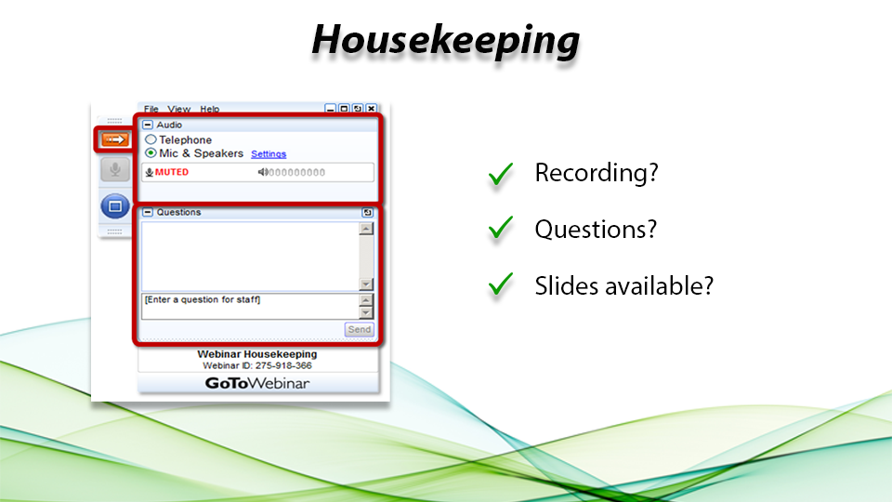

Slide 5
Psycho-Social Impact Assessment
Facilitator
Will Rifkin
University of Newcastle
Australia

Slide 6


Why you are here
Understanding the basics of Psycho-Social Impact Assessment (PSIA)
Methods and tools for identifying, measuring, and evaluating psycho-social impacts
Integration of PSIA into Environmental and Social Impact Assessments (ESIA)
Addressing historical injustices and community distrust in impact assessments
Psycho-social impacts on indigenous communities and traditional populations
Mitigation measures and management of psycho-social impacts
Psycho-social impacts in specific contexts (e.g., mining, climate change, workplace)
Best practices and emerging trends in PSIA

Slide 7









PSIA Working group
Sergio Moreira, PhD
Community Insights Group

Slide 8
PSIA Working group
IAIA21 | Psycho-social impact assessment as an element of your work
IAIA22 | Measurement, methods, & meaning in
psycho-social impact assessment
FasTips 2023 | Psycho-Social Impact Assessment
IAIA23 | Not the same, not so different: Distinctive features
in SIA, PSIA and HIA
IAIA24 | Psycho-social impact assessment to help
make transformation more just
Webinar | Psycho-Social Impact Assessment – past, present and future

Slide 9
What is PSIA?
“subset of social impacts arising from projects that specifically relate to the mental health, psychological wellbeing and emotions of people”
“impacts (…) in how people experience their world, (…) their patterns of daily activities (…), as well as their mental health”
the human experience of impacts
Rifkin et al. (2023)
Edelstein & Vanclay (2024)

Slide 10

How does PSIA fit within IA Practice?
SIA
CLIA
EIA
GBIA
HIA
HIA
HRIA
PSIA
?
?
?
?
?

Slide 11
Why does PSIA Matter?
Understanding Impacts
Mental Health
Community Perceptions
Trust & Fairness
Acceptance
Conflict & Contestation
Social & Place Identity
Norms & Values
Developing Plans
Stakeholder Engagement & Grievance Mechanisms
Community Agreement
Community Investment
Health & Safety
Livelihoods Restoration
Local Talent & Procurement
Social Impacts
Health Impacts
Psycho-Social Impacts
human Experience
Human Rights Impacts
Gender Based Impacts

Slide 12

Origins of PSIA
Michael R. Edelstein, Ph.D.
IAIA Webinar Nov. 18/19 2024

Slide 13
How PSIA became my mission & What I learned
1970s
  Merion Blue Grass
  Love Canal
1980s
    Turi Landfill Richton Dome HLNWF
  Ayers v Jackson Twp. Triana DDT Exposure
  Stress & TMI Hanford HLNWF
  Loss of Livelihood EDB in Birdsview
  Family Disintegration CECOS SCRF 6
  Stigmatizing Aspects BRIO Superfund Site
  Ozone Notification
1990s
  Oiled Communities
  Texas City Hydroflouric
Lessons:
Proactive (US NEPA, SEPA, Permit Hearing) and
Reactive (disaster) applications
Process magnifies impact
Generalizability between cases; importance of theory
Environmental Injustice and ‘Perpetual Jeopardy’
PSI hard for decision makers to consider; few experts
Superfund/remediation/clean up/mitigation -> impacts
Easy to pollute, but impossible to decontaminate

Slide 14
Social Process in Eco-Historical Context
Impacts at all levels of social process
Levels nested, interactive, interdependent
Dynamics at
any one level
influence all levels
Societal / Public /
Commons / Global
Individual /
Private / Local
Historical
Ecological
Edelstein 2004
Notes:
Eco-historical context means that change is always cumulative; P-SIA form of social science that objectively examines impacts to people
Any given situation might evidence some impacts, not others
Impacts may be severe, mild or absent
Open to case specific dynamics and results
How to drive for depth of understanding

Slide 15
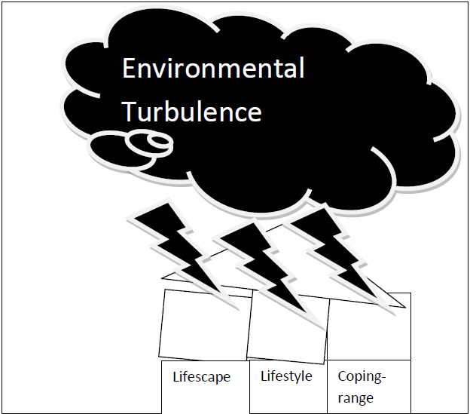
Theory: Elements Of Psycho-Social Impact
Lifestyle
Lifestrain
Lifescape
Edelstein 2004
Notes:
ascertain whether core understandings are challenged by the new situation and how such challenges are resolved
patterns of behavior that individuals (mirroring the society and others) engage in during the course of everyday life and how such basic actions are modified to address contaminating change

Slide 16
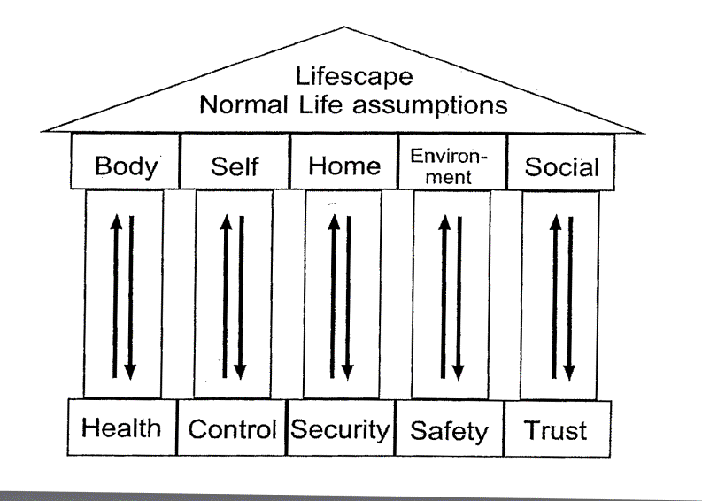
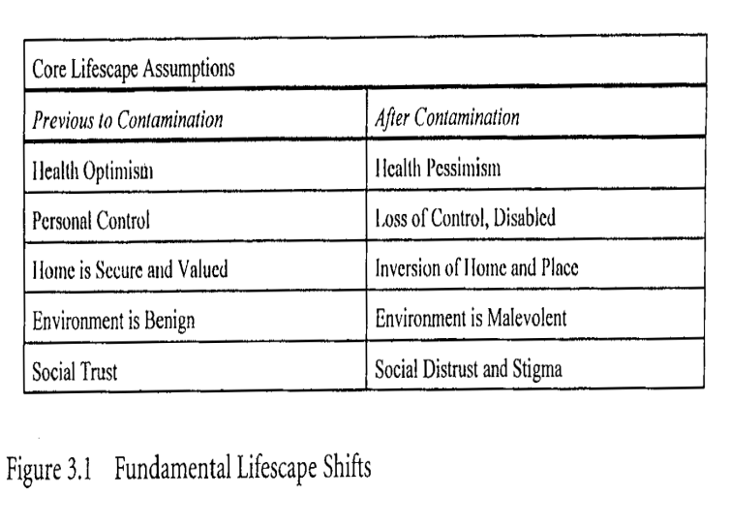
LIFESCAPE: Altered Understanding of Daily Life
r
Edelstein 2004

Slide 17
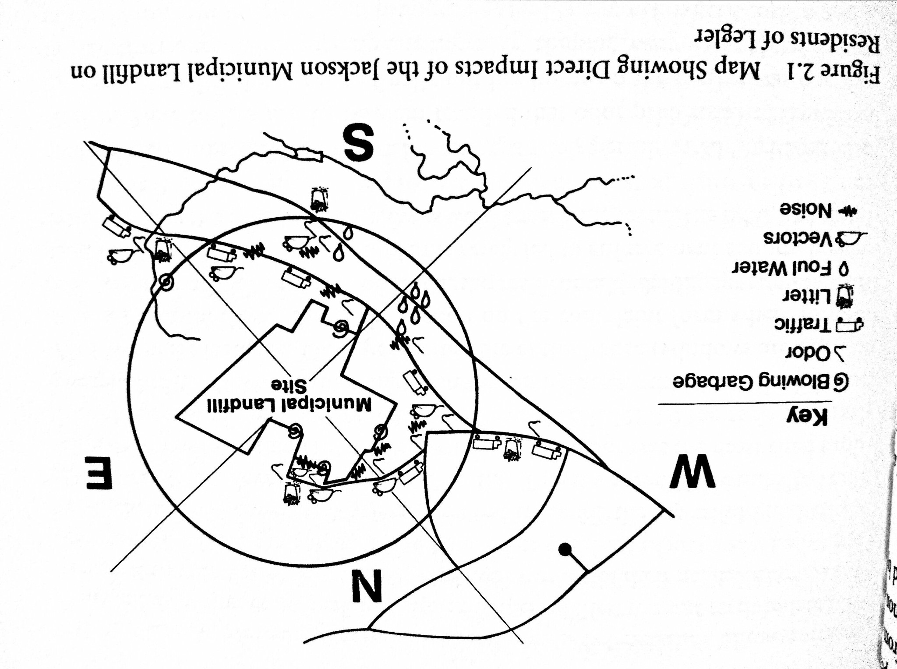
LIFESTYLE: Adjustments and Adaptations to Normal Activity Patterns
Direct Impacts:
Edelstein 2004
… a new ‘cumulative surround’
Changed behavior
Adjust daily life to new conditions
Alter habits
Loss of Normalcy
  Avoid use of water
  Limit access to home and property
Wear pollution mask
Time spent on dealing with crisis
Changes driven by ill health
Meaning of changes
Temporary or permanent
Forced on you
Notes:
While the original pattern itself is invisible to those living in a society of people acting the same way, lifestyle that is forced to change comes to be recognized and have meaning. There is thus a connection between alterations of lifestyle and lifescape and between lifestyle and emotional health and well being. Isolated lifestyle impacts are often treated as nuisances and, while annoying, are not significantly harmful to psychological wellbeing. In contrast, repeated intrusions into lifestyle become significant impediments to “normal” life and can be extremely stressful. This is particularly true when intrusions are noxious, threatening or when people are forced to do things that they do not want to do.

Slide 18
LIFESTRAIN: Stress and Coping
Coping Challenges
Perception: incubation, discovery,
announcement, acceptance
Shift to perpetually abnormal
Stress and coping impacts
Exceed coping resources
New reality - culture shock
Changed psychological well being
Anticipatory fears
Psychological and social dysfunction
Affected by exposure AND response
Changed Relational Dynamics
Relational network inadequate
Reliance on experts is disasbling
Environmental stigma
Enabling responses
Forced into new roles and actions
Community conflict
Outsiders don’t understand
Environmental Injustice
Limbo
Notes:
psycho-social wellbeing, or the emotional costs of change. Victims of contamination confront various kinds of stressors to which they are forced to adjust or adapt. People and groups vary at how much stress they can handle, their resources for coping and their adaptive capacity. Some seek to avoid the feeling of stress while others seek to avoid the causes of stress. In either case, the victim’s psycho-social wellbeing is likely to have been altered both by direct or secondary impacts of the situation and by anticipatory fears of what may occur in the future.

Slide 19
Lifecycle x Impact
Age | Lifestyle | Lifescape | Lifestrain | Stigma | Relations
Child
Teen
Young Adult
Parent
Elder

Slide 20
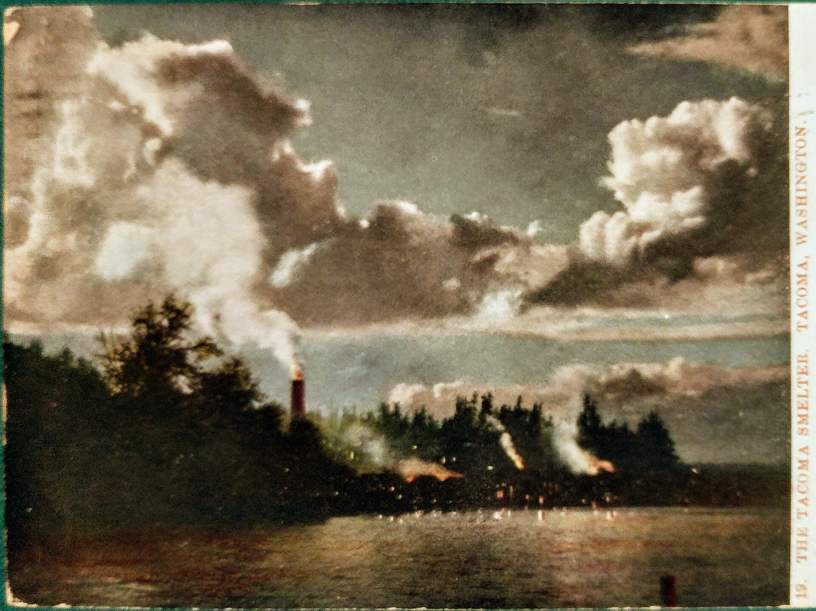
ASARCO Copper Smelter
1880s -1985 Rustin / Tacoma Washington
Major source of employment
Dominant in arsenic production for
lumber treatment & pesticides
The 573-foot chimney built 1918 to disperse effluents & avoid local complaints
Air polluted with sulfur-dioxide and arsenic
1,000 square miles of Puget Sound basin - soils polluted with arsenic, lead,
other heavy metals
1909 Post card https://en.wikipedia.org/wiki/ASARCO

Slide 21

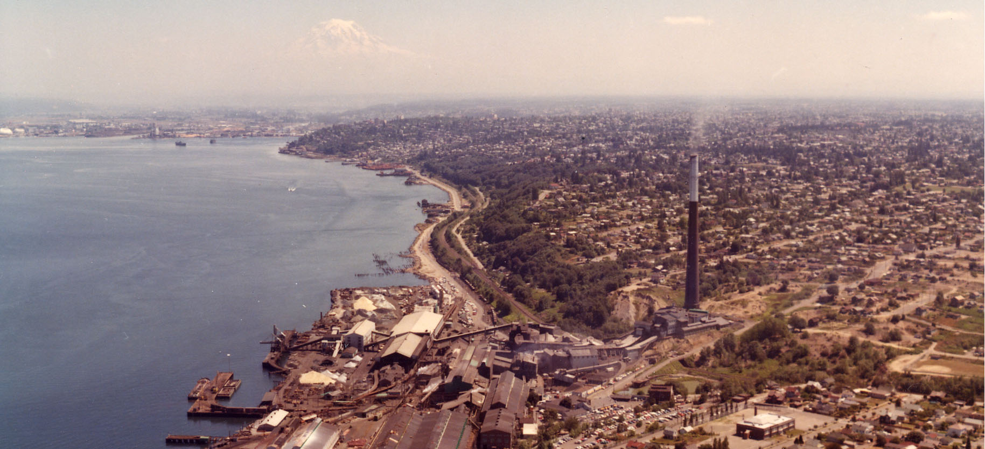
https://ecology.wa.gov/Spills-Cleanup/Contamination-cleanup/Cleanup-sites/Tacoma-smelter

Slide 22
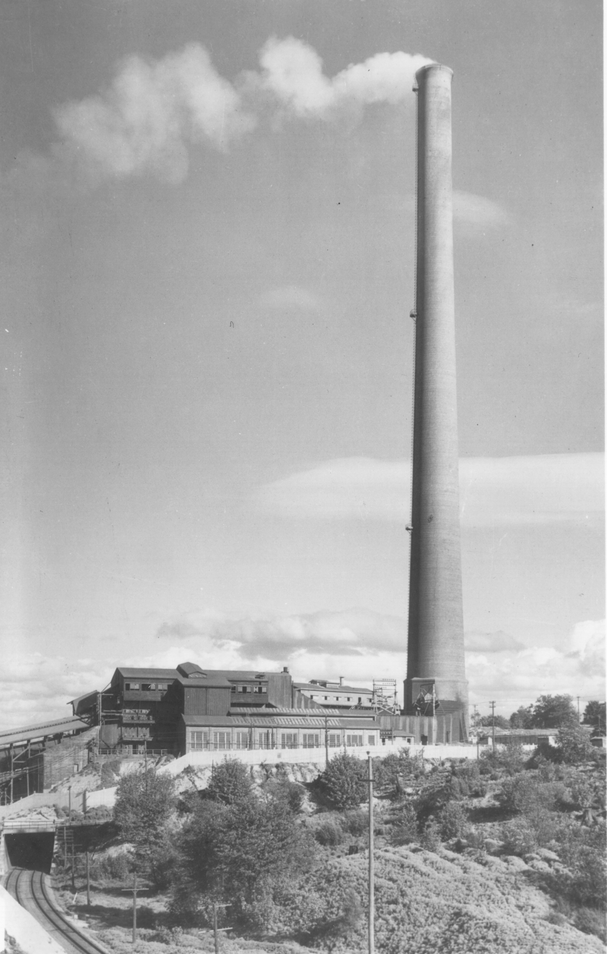
Mid-1990s
EPA required ASARCO to start Superfund cleanup in worst areas. One square mile site designated.
Study of Psycho-Social Impacts of living in Superfund site
-> litigation
Field study in North Tacoma & Ruston, Washington:
June 20 - July 1, 1994
Residents, businesses, officials; + observations during 2-week residency
100-page summary of results.
https://apps.ecology.wa.gov/cleanupsearch/site/3657

Slide 23
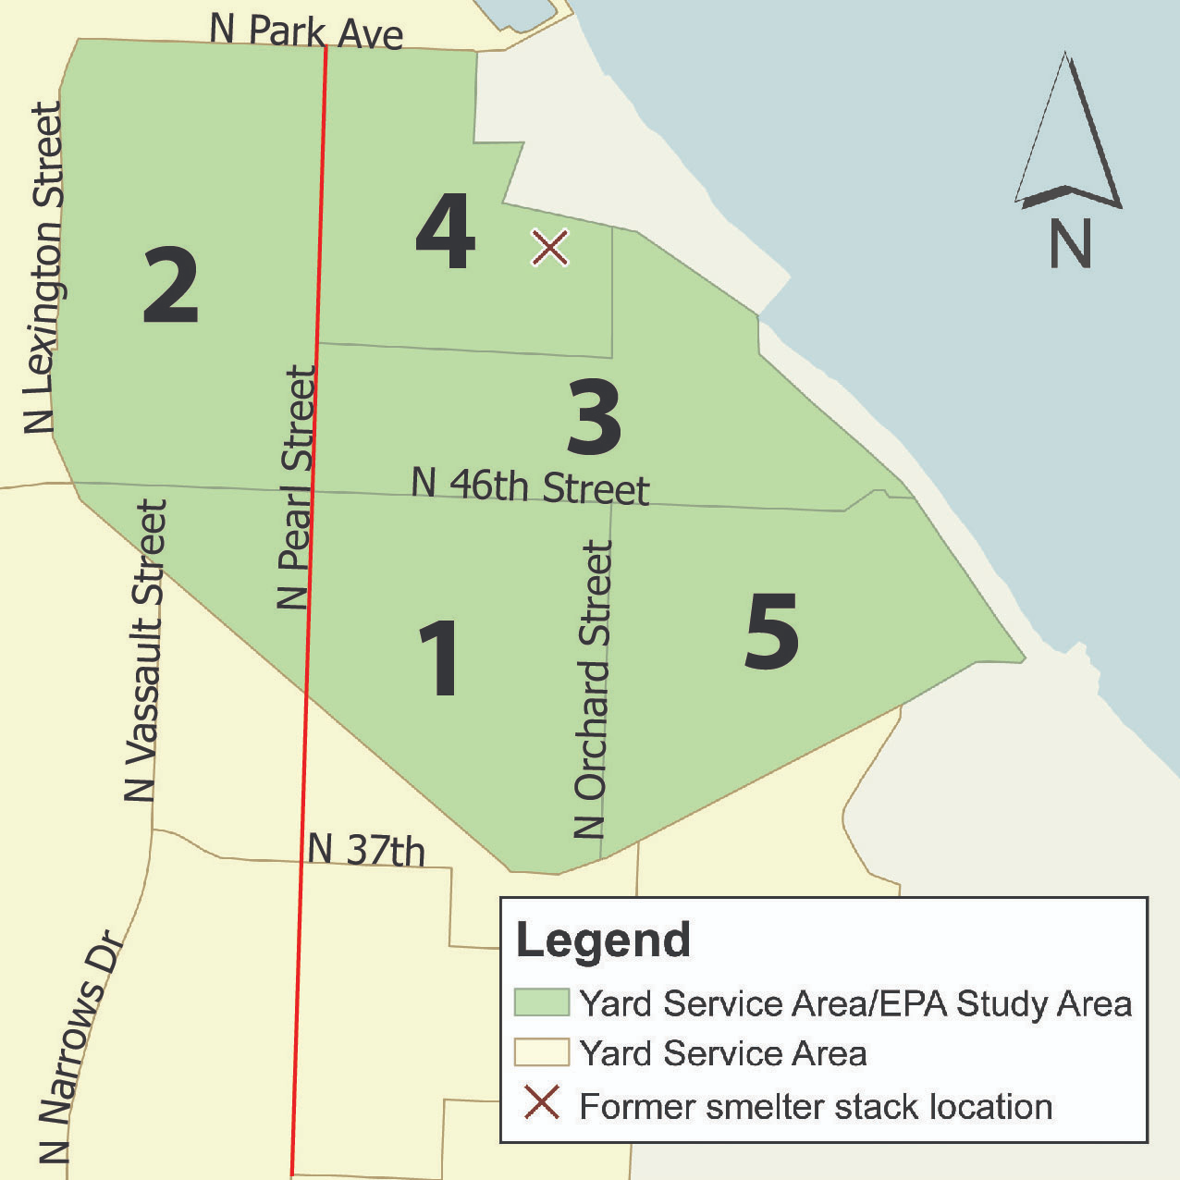
Ruston / NorthTacoma Study Area
Findings:
Sense of uncertainty
Experience influences perception
Environmental stigma
Lifestrain / stress / coping / disruption
Anticipatory fear
Lifestyle impact / Precautions
Adverse impacts from cleanup
Impacts on ‘lifescape’
Health concerns
Lost sense of control
Inversion of Home (no longer ‘safe’)
Environment means danger
Distrust of government & industry & others
https://ecology.wa.gov/spills-cleanup/contamination-cleanup/cleanup-sites/tacoma-smelter/history-and-studies

Slide 24
E.g., Finding 1: Uncertainty
Pervasive uncertainty over location and effects of smelter contamination reduced residents’ ability to cope effectively, enhancing stress.
Information vacuum allowed for divergent interpret-ations, making it easy for existing beliefs about ASARCO and risk to determine residents' understanding of what was occurring.
Cleanup introduced new uncertainties.
Until I get hard evidence as to the risks for my daughter, I don't feel comfortable letting her play around the dirt.
EPA says lead is dangerous and Asarco says it isn’t. Who do I believe? I am not expert. Meanwhile, I have to take precautions.
Should I eat from my garden?
E.g., Finding 13: Distrust
Social distrust for ASARCO and especially for government.
Blame neighbours and others.
Technological distrust in evidence and cleanup.
I am almost anti-government the way they cover things up. I think they knew years before. It is big business. They kept a hush on it.
The fact that the DOE safe level was considerably less than what EPA said was safe led some residents to question whether EPA was looking out for their interest.
EPA is trying to get Asarco to clean up even if the cleanup will not fix the problem.

Slide 25
My work demonstrates that PSIA can be used to develop generalizable theory and a substantial literature, where theory is tested, refined and extended.
In Conclusion

Slide 26


Recognising cultural dimensions in psycho-social impact assessment
Helen Ross
Prof. Emeritus
The University of Queensland
Australia
Helen.ross@uq.edu.au
www.linkedin.com/in/helen-ross-b2aab22/
http://www.uq.edu.au/agriculture/
Insert presenter headshot here.
CLICK & DELETE THIS TEXT BOX.
Gija and Miriwoong dancers at Warmun, May 2003

Slide 27

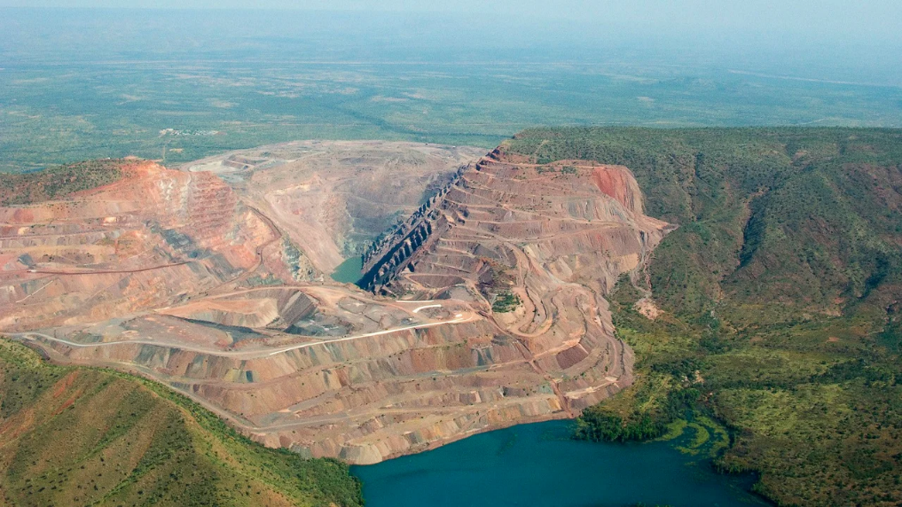
Warmun community
Argyle Diamond Mine: studied 1980s
Method – community controlled study,
oral histories
Cumulative impacts over time
Mine PSIs
Distress and outrage, powerlessness
Cultural responsibilities
  Deeply fearful of supernatural retribution
Community split with deep grievance
Collective resistance and campaigning
  Empowering, emphasised their small gains.
Mining Technology, projects, 2 February 2021, https://www.mining-technology.com/projects/argyle/?cf-view

Slide 28
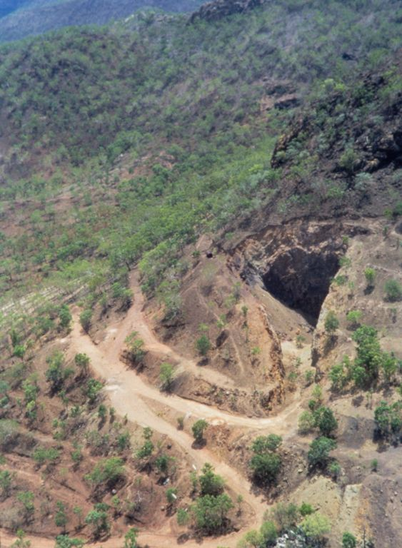
Coronation Hill
Proposed gold mine, national enquiry
Method: ‘Strategic Perspectives Analysis’ interviews
within consultancy for the enquiry
PSIs
Huge internal divisions, distressing conflict among the Jawoyn
Related to degrees of cultural beliefs and values, other values
  in context of social distress
Somewhat assuaged later by
  vindication of the elders in cultural beliefs
  clever healing processes by younger Jawoyn leaders, alternate
  economic development
Library and archives NT, https://hdl.handle.net/10070/313910

Slide 29
PSIA Complexities
Jeffrey B Jacquet
Associate Professor
School of Environment and Natural Resources
Ohio State University

Slide 30
Psycho-Social or Social-Psychological?
Answer:

Slide 31
Psycho-Social or Social-Psychological?
Answer: Yes!
Psycho-Social
Social-Psychological
Psychological
factors
Social
Factors
Social
Outcomes
Psychological Outcomes

Slide 32


Psycho-Social or Social-Psychological?
Psycho-Social
Answer: Yes!
Psychological
factors
Loss of Culture
Fear of Unknown Increased Stress
Social
Outcomes
Social Conflict
Disrupted Relationships Increased Substance Abuse

Slide 33
Psycho-Social or Social-Psychological?
Answer: Yes!
Social-Psychological
New People in Town
Increased Conflict
Increased Prices
Social
Factors
Psychological Outcomes
Disrupted Identity
Loss of Trust
Increased Stress

Slide 34
Psycho-Social & Social-Psychological
Social
Factors
New People in Town
Increased Conflict
Increased Prices
Psychological
factors
Loss of Culture
Fear of Unknown Increased Stress
Social
Outcomes
Social Conflict
Disrupted Relationships Increased Substance Abuse

Slide 35

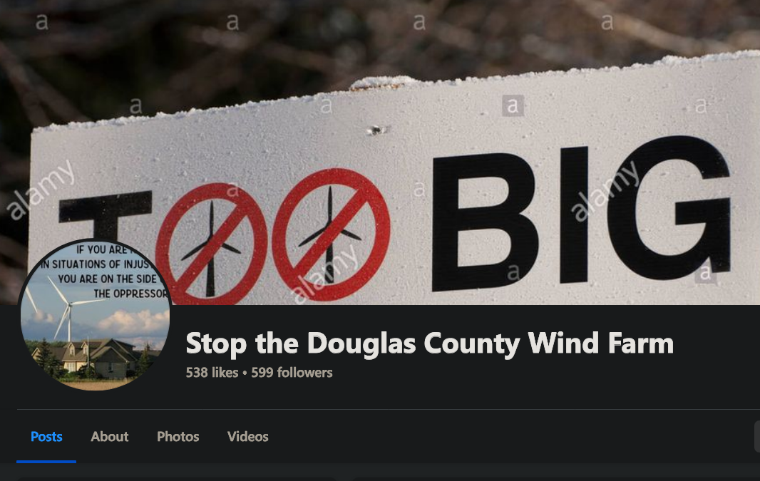


Example: U.S. Wind Energy Projects
Social
Factors
Conflict over siting
Mis/Dis-information
Unjust Outcomes
Psychological
factors
Loss of Culture
Feeling Helpless
Stress/Worry
Social
Outcomes
Social Conflict
Disrupted Relationships Blocked Development

Slide 36
Take-aways
PSIA -> combination of physical, social, and psychological factors.
Factors are inter-dependent & interact in complex ways
Follow the impacts to see how they interact
Where you start does not matter to findings of PSIA as long as
both psychological and social impacts are being assessed

Slide 37
Where is the Field Heading?
Community-Project Relations
Stakeholder Engagement &
IA Streamlining
Psychology- Informed IA
Psycho-Social Impact Assessment

Slide 38
Upcoming PSIA Activities
IAIA25 | Evolving the state of the art in
Psycho-Social Impact Assessment
IAIA25 | Psychology-Informed Impact Assessment Training
In preparation | Chapter for HIA Handbook
In preparation | Review article on PSIA
In preparation | Handbook in Community-Project Relations

Slide 39
Questions & Answers
Will
Rifkin
Ruari
Carthew
Jeffrey Jacquet
Catherine
Fairbairn
Eden
Klein
Helen Ross
Cathy Banwell
Sergio Moreira
Michael Edelstein

Slide 40
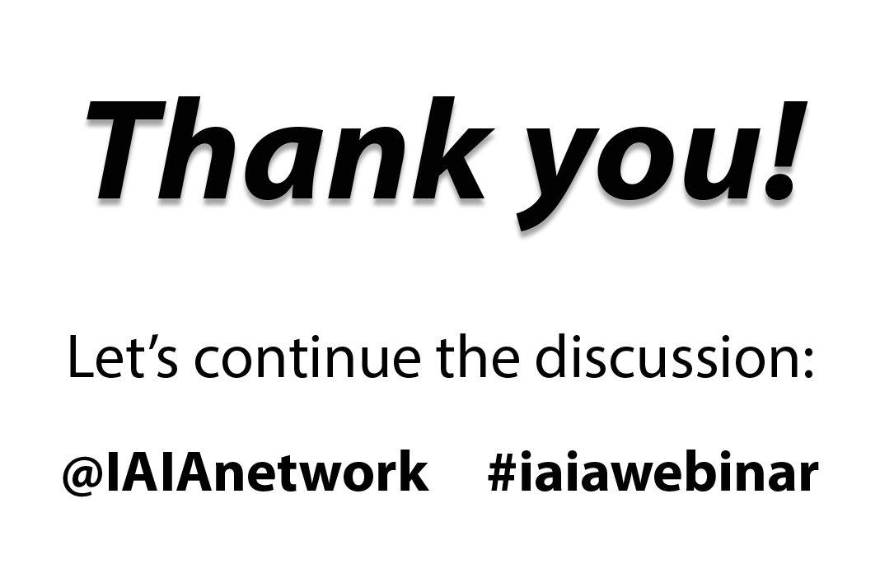

Slide 41
Finding 1: Uncertainty
A pervasive sense of uncertainty exists with regard to the distribution and consequences of contamination from the Asarco smelter. Residents have very little solid fact upon which to base their judgments of the situation. This uncertainty complicates effective coping and enhances stress ...
Pervasive uncertainties allow for divergent interpretations. This situation makes it easy for existing beliefs about risk and about Asarco to determine a given resident's understanding of what is occurring.
The Superfund cleanup has introduced numerous new uncertainties into an already confusing situation.
Until I get hard evidence as to the risks for my daughter, I don't feel comfortable letting her play around the dirt.
EPA says lead is dangerous and Asarco says it isn’t. Who do I believe? I am not expert. Meanwhile have to take precautions.
Bonus content:
Details from analysis
of Asarco Case
Michael R. Edelstein, Ph.D.
IAIA Webinar Nov. 18/19 2024

Slide 42
    Finding 2: Implications
    … Despite periodic waves of publicity about events related to the Asarco smelter, it was not until the EPA meetings and newsletters dealing with the residential cleanup commenced that some community residents understood the implications of what they had experienced and heard about previously ….
    Long-term residents were adapted to an industrial environment. …The "Tacoma Aroma" was widely identified as being a symbol of the area.
    Even residents concerned about risks associated with Asarco viewed [its] stack as an important landmark and historical site.
    When the officials told them to take precautions with gardening, to wear gloves, to prevent small children eating dirt, etc., "I started to realize how this was going to affect small day-to-day decisions."
As the EPA cleanup commenced, residents in the first Zone were notified of testing for their yards. In some cases, this notification was the first time that a resident knew about the contamination.
Finding 3: Stigma
Because there will be contaminants remaining after the cleanup, with property management and real estate transfer implications, environmental stigma has been one of the consequences ….
In short, the perception of contamination may well continue after the "cleanup" is completed.
If somebody wanted to buy my house and had 2 little kids, and they are like me, they will not know whether they want to let the kids play there, and they won't buy the house.
The area is marked in people's minds. They would not be likely to bring children into the area.
Would a buyer buy in a Superfund area?
.

Slide 43
    Finding 4: Anger
    There have been numerous and continuing disruptions and sources of stress for residents … [that] relate to residents' lifestyle and lifescape.
    Sometimes I wake up in the middle of the night and realize I did not vacuum the carpet.
    A respondent highly stressed from cancer is now afraid to dig in her own yard.
    They feel anger that they were never told of precautions until last year. And they are angry at the prospect of having to live in the future with precautions so as to minimize the costs for Asarco. It is unfair that the burden of proof is put on the resident.
    She is angry over her cancer. She had just retired one month before.

Slide 44
Finding 5: Fear
Anticipatory fears concerning the potential health effects of arsenic and lead exposure are reported by a significant number of residents.
Because there will be contaminants remaining after the Superfund cleanup, such fears may become inherent to this community.
If this is a problem, and we lived here all these years, then we are already exposed to it.
In 5 years, they could come and say that 50% of the people here have cancer because of the arsenic. They come up with new things all the time.
Finding 6: Precautions
Lifestyle impacts … involve the need to alter daily patterns of activity and to forgo enjoyment of one's property in often significant ways ... including precautionary steps taken by residents, and special efforts to deal with children, the elderly, yards, gardens and house interiors ….
Basically, we have lost the use of the outside of the house.
Has concern for his children and grandchildren. They make them wash when they come in if they are visiting. It is hard to get the kids to clean up after every time they touch something. We have a close family. We always have kids visiting. We only let them on the patio.

Slide 45
Finding 7: Adverse impacts
The period of remediation and cleanup has brought very specific adverse impacts to the community that include disruption, noise, intrusion, lifestyle change, demand for supervision of activities, the need to negotiate over the acceptable outcomes for properties and visual reminders of risk.
These [impacts] represent significant stressors for residents, regardless of whether they believe or disbelieve that there is a significant health risk associated with the contamination itself.
Expect it will take 10 years, by the time we are 60.
They told us not to dig in the dirt or plant plants, eat fruit, let the kids play in sand at school or in the dirt. But the kids played every day at school. How do you stop kids from playing?
Finding 8: Impacts on lifescape
Changes are also evident for some residents in their basic outlook on life - what I term the lifescape - the basic assumptions made by people about the course of life. Specifically, these lifestyle impacts are discussed in the next five findings.

Slide 46
  Finding 9: Health concerns
  Some residents appear to have undergone a shift of their life expectations about health, either using the Asarco contamination to explain existing health problems or to anticipate future ones.
  Health concern was particularly pronounced amongst parents concerned for the health of their children.
  - Youngest child delayed learning---is it from eating soil?
  - Child's leukemia due to smelter (potentially).
  Eric got cancer from the dang smelter.
  - Lost uncle and husband to cancer. Before they became ill, both worked in yard. Questions whether soil had something to do with it. Neighbors died of cancer, too. Kept returning to cancer. New realization.
  Son got asthma at 6. "Did we move here and hurt our son”
Finding 10: Sense of control
… Many residents appear to have lost, to varying degrees, their sense of control over their own destinies. Evidence of "disablement" due to dependence upon government agencies and to Asarco is evident.
Could decide to give up smoking, but not this
It makes a difference that it was caused. It was preventable. They (Asarco) knew it was happening and never told. Wouldn't have moved if known. They let people believe everything was fine.
In face of a big corporation and government is backing them, "the little guy feels pretty defenseless."
They can gain control over contamination by avoiding exposure (although there is a loss of control in doing it).
The lawsuit is viewed by active participants as a means to regain control.

Slide 47
Finding 11: Home
Many residents have fundamentally changed the way they think about their homes and property as the result of contamination.
Particularly regarding yards, the exterior portion of the home, severe impacts have occurred in terms of feelings of safety and freedom to engage in desired activities ….
They took away our sense of well-being inside your own home.
Are you going to invite people for "arsenic burgers"?
I almost feel like a prisoner in my own home. Home ceases to be a home, It is only a house.
Finding 12: Environment -> danger
… The local environment is no longer seen as free of environmental danger ….
The perception that arsenic and lead are pervasive in the community: in attics and crawl spaces, in the yards that are not or will not be cleaned up, in alleys, in open dirt piles in the community, in bare patches of soil in yards, in dust and wind, …
The recognition that heavy metals are persistent over time and don't diminish.
The threat involved in coming in direct contact with dirt.
Fear that track dirt in when come in from outside.
There were no birds or worms there during plant operation, birds starting to return. (McGinnis)
Fish caught in area have gross abnormalities.

Slide 48
Finding 13: Distrust
Social trust, specifically trust for government, has been shaken or reinforced in a negative way for many respondents. Distrust of Asarco was also evident.
Partially as an outgrowth of these two social distrusts, there also is a technological distrust in evidence - distrust of the cleanup.
Some personal and interpersonal blame was also in evidence.
I am almost anti-government the way they cover things up. I think they knew years before. It is big business. They kept a hush on it.
The fact that the DOE safe level was considerably less than what EPA said was safe led some residents to question whether EPA was looking out for their interest.
EPA is trying to get Asarco to clean up even if the cleanup will not fix the problem.
    "Asarco denies everything, and EPA does studies." However, even if EPA is a good organization, it can't control Asarco. Can't blame Asarco for delaying, but EPA for letting them.
    If soil is too dangerous to go to the dump, then they should move people out.
    EPA did not give a damn about property values.
    I realize Asarco could bow out at any time and go broke, and the EPA is supposed to pick up that note …. I could be left sitting where this land and all I worked for become useless. … It is like being attacked by vultures.
    I do not trust Asarco to do the cleanup. They caused the problem. How do we know they will not take shortcuts?
    If contamination remains under fences and rockeries and heavy shrubs and below 1-1/2 feet, then it is not a total solution -- we need to relocate.

